Slide 1
Sales Performance & Customer Segmentation Analysis
13 May 2026

Slide 2
Agenda
Executive Summary
Business Overview & Problem Understanding
Analytical Approach & Methodology
Sales overview by Categories & Customer Segmentation
Cumulative Contribution Analysis – Pareto Analysis
Trendlines , Growth % on MoM , AOV , Orders and Forecast
Strategic Recommendations

Slide 3
Executive Summary
Focus Area
Key Strategic Insights
Revenue Performance & Regional Dominance
The business has generated a total revenue of 732.10K from 500 total orders
The North region is the primary driver of growth, contributing the highest individual revenue share (275.85K), followed by the South.
Growth Dynamics & Forecasting
While the latest Year-over-Year (YoY) revenue growth shows a massive surge of 248.99%, the latest Month-over-Month (MoM) revenue has declined by 26.86%
revenue to trend upward toward the 50K–60K monthly range by mid-2024.
Customer Segmentation & Retention Risks
A significant portion of revenue is tied to the "At Risk" segment (contributing 60.14K in the South region alone)
No individual or 20% group of customers contributing to huge Revenue, Revenue evenly spread across customers.
Channel & Product Strategy
Offline sales remain the dominant force, accounting for approximately 55.96% (409.71K) of total revenue compared to 44.04% (322.38K) for online channels.
Office Supplies is the top-performing product category by a wide margin, followed by Clothing and Electronics, while Furniture remains the smallest revenue contributor.

Slide 4
Business Overview & Problem Understanding
Business Context
Data Understanding & Inventory
Strategic Problem Statement
Organization: ABC Corp is a multi-regional retailer specializing in a diverse product portfolio across four key regions: North, South, East, and West.
Operational Channels: The company utilizes a dual-channel sales strategy, leveraging both Online and Offline touchpoints to reach its customer base.
Market Presence: Current operations span multiple segments contributing to a total revenue footprint of 732.10K.
Dataset Structure: The analysis is built upon a Star Schema involving three primary datasets: Sales, Products and Customers
Products & Customers: The portfolio includes 15 unique products classified into 4 categories (Office Supplies, Clothing, Electronics, and Furniture).
The customer base consists of 50 unique individuals distributed across the 4 operating regions.
Sales Transaction Details: The dataset included 500 sales data with unique sales Id, Product Id, Quantity and Total Amount mentioned.
Performance Disparity: Leadership suspects that performance is inconsistent across different regions and product categories, requiring a formal identification of key sales drivers.
Value Concentration: There is a specific concern that a significant portion of the company's total value is concentrated within a small, narrow segment of the customer base.
Core Objectives: The primary tasks are to segment customers based on value and behaviour, pinpoint underperforming areas, and develop data-driven growth strategies to balance the revenue profile.

Slide 5
Analytical Approach & Methodology
Data Preprocessing
Model Creation (Star Schema)
Insight Derivation & Visual Analytics
1
2
3
Sales Overview: Utilized Bar and Pie charts to visualize revenue splits by Channel, Region, and Category, highlighting that Offline sales drive 56% of total revenue.
Customer & KPI Tracking: Applied a Bar-Line chart to measure individual customer contribution to Revenue.
Created DAX measures for core KPIs like Revenue (732.10K), Order Count, and AOV.
Growth & Trends: Integrated a Multi-line chart to track growth percentages for Revenue and Orders against a Year-Month timeline, identifying key fluctuations like the 248.99% YoY surge
Feature Engineering:
DAX Measures: Created dynamic KPIs for Total Revenue, Total Orders, and Average Order Value (AOV) .
RFM Logic: Developed an RFM_Base table for advanced customer segmentation (e.g., Champions, At Risk, Loyal).
Time Intelligence: Created dim_calendar table to support Month-over-Month (MoM) and Year-over-Year (YoY) growth analysis.
Implemented a robust Star Schema
Fact-Dimension Relationship:
Connected fact_sales to four primary dimensions: dim_products, dim_customers, dim_calendar, and the RFM_Base segment table.
Relationship Cardinality: Established one-to-many (1:*) relationships between dimensions and the fact table.

Slide 6

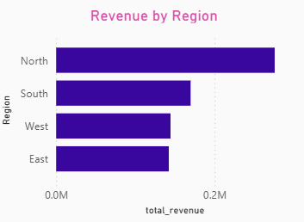




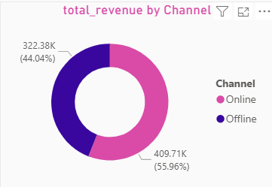
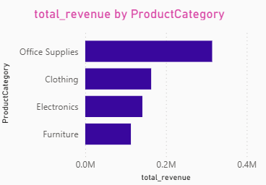
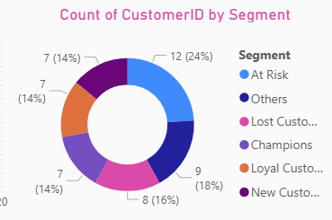
Sales overview by Categories & Customer Segmentation
North Region Dominance: The North region is the primary revenue engine, contributing 275.85K, which is significantly higher than other territories.
Office Supplies as a Market Leader: This category outperforms all others, indicating a strong product-market fit that can be leveraged for cross-selling opportunities.
Channel Strategy Shift: While Offline sales (56%) currently lead, the 44% Online share shows a strong digital footprint that can be expanded to reduce physical overhead costs.
Critical Retention Alert: Approximately 24% of the customer base (12 customers) is classified as "At Risk," representing a significant portion of potential lost revenue, particularly in the South region.

Slide 7
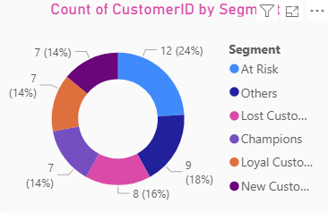
Customer Segmentation Logic
Segment | Recency (R) | Frequency (F) | Monetary (M) | Business Interpretation
Champions | 4-5 | 4-5 | 4-5 | Your best, most valuable customers.
Loyal Customers | 4-5 | 3-5 | Any | High engagement and recent activity.
New Customers | 4-5 | 1-2 | Any | Just started buying; need onboarding.
At Risk | 1-2 | 3-5 | Any | Frequent buyers who haven't returned recently.
Lost Customers | 1-2 | 1-2 | Any | Low value and inactive for a long time.
Recency: Measures how much time has passed since a customer's last purchase; a lower number of days indicates a higher engagement level.
Frequency: Tracks how often a customer completes a transaction over a specific period, distinguishing occasional buyers from habitual ones.
Monetary: Quantifies the total revenue generated by a customer, identifying the high-spenders who contribute most significantly to the bottom line.

Slide 8
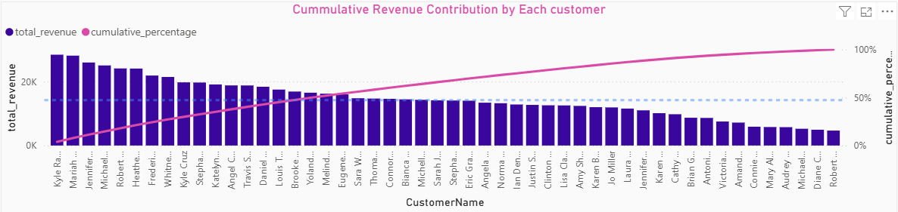
Sales overview by Categories & Customer Segmentation
Balanced Revenue Distribution: The cumulative percentage line shows a relatively steady and gradual incline, suggesting that revenue is not dangerously concentrated in just a few individuals but is instead distributed more evenly across the top half of the customer base.
Absence of Pareto Extremes: Unlike typical "80/20" scenarios where a tiny fraction of customers drives most value, this visual indicates a healthy spread.
Yet, 50% of Revenue is being contributed by 32% of Customers (16 Customers )

Slide 9
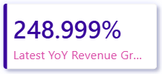
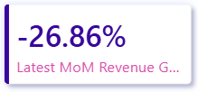
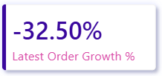

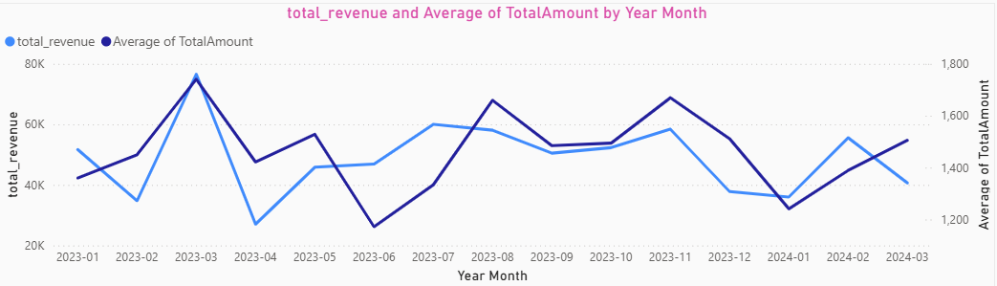
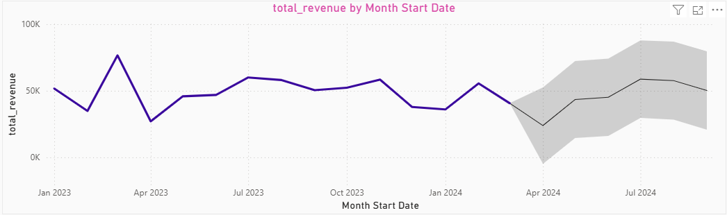
Trendlines , Growth % on MoM , AOV , Orders and Forecast
Growth Percentage % :The latest YoY Growth % is 248.999%, latest Mom Growth % is -26.86%, latest Order Growth% is -32.50% and latest AOV Growth % is 8.36%.
Historical Revenue Volatility: Revenue experienced significant peaks in March 2023, July 2023 and November 2023 with a notable dip in April 2023.
Fiscal Year Exit: The 2022 financial year exited with a peak followed by a dip in the start of 2023 financial year.
Predictive Outlook: The forecast model anticipates a drop in beginning of Q1 and gradually restores, with revenue projected to return to the 50K–60K monthly range by July 2024.

Slide 10
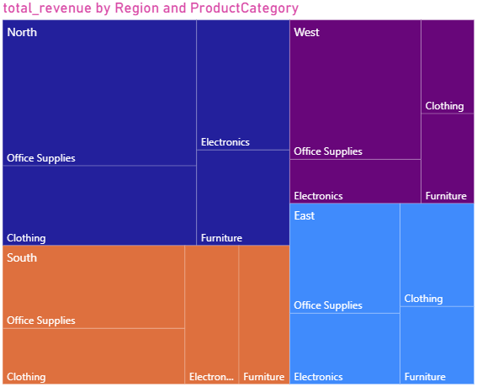
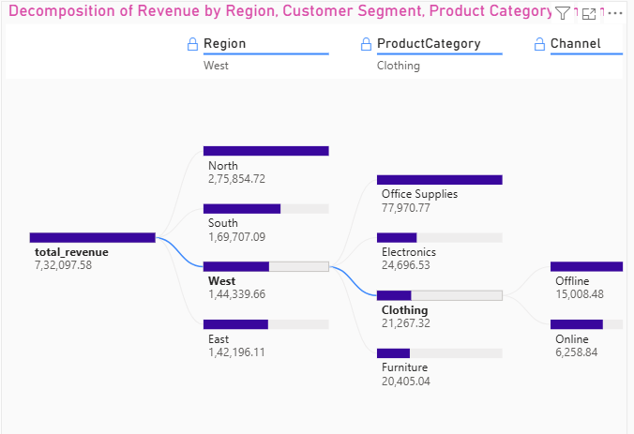
Tree Map & Decomposition Tree
North Dominance: The North region is the leading revenue driver, contributing 275,854.72, which is nearly 38% of the total company revenue.
Secondary Markets: The South region follows as the second-largest contributor (169,707.09), while the West (144,339.66) and East (142,196.11) regions show closely matched performance levels.
Office Supplies Lead: In the West region, Office Supplies is the primary product category, generating 77,970.77 in revenue
Balanced Sub-Categories: Other categories in the West—Electronics (24,696.53), Clothing (21,267.32), and Furniture (20,405.04)—show a relatively even distribution of sales volume.
Offline Preference: For Clothing sales in the West region, the Offline channel is significantly more effective, bringing in 15,008.48.
Online Growth Opportunity: The Online channel contributes 6,258.84 for West-region Clothing. This represents a potential growth area for digital marketing and e-commerce optimization.

Slide 11
Key Insights & Strategic Recommendations
Category | Key Findings & Performance Metrics | Strategic Recommendations
Retention & Churn Risks | Approximately 24% of the customer base (12 customers) is classified as "At Risk". In the South region alone, this segment represents 60.14K in potential revenue vulnerability. | Deploy targeted re-engagement campaigns and personalized discounts for "At Risk" customers. Investigate the root cause of the 26.86% MoM revenue decline
Regional & Channel Expansion | The North region is the dominant revenue engine (275.85K). Offline sales lead with 55.96%, but the 44.04% Online share shows strong digital conversion potential. | Replicate the successful "North Model" of product-market fit in underperforming regions like the East. Boost digital margins by launching exclusive online promotions for Office Supplies.
High-Value Loyalty | Steady Transactional Value: Despite month-to-month revenue fluctuations, the Average Order Value (AOV) has remained resilient with an 8.36% growth. This indicates that your loyal segments are consistently spending more per visit, regardless of total order volume | Value-Based Upselling: Shift focus from increasing order frequency to increasing basket size. Since customers are already showing a willingness to spend more per transaction, introduce premium product bundles or "Free Shipping" thresholds slightly above the current 1.46K AOV to further drive ticket size.

